Slide 1
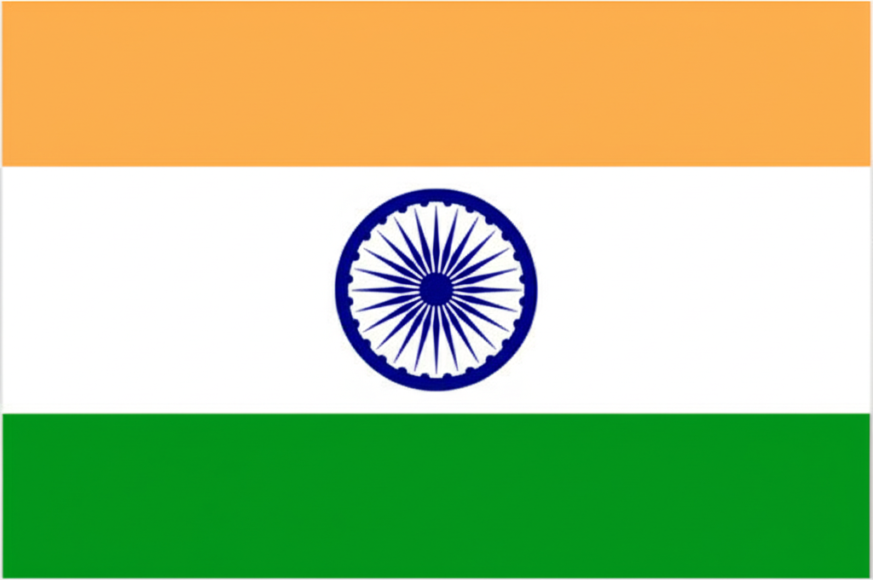
Indian Independence: A Journey to Freedom
This presentation delves into the historical struggle and the eventual triumph of India in gaining independence from British colonial rule. From early resistance to the final moments of partition, we trace the significant milestones that shaped a nation.

Slide 2
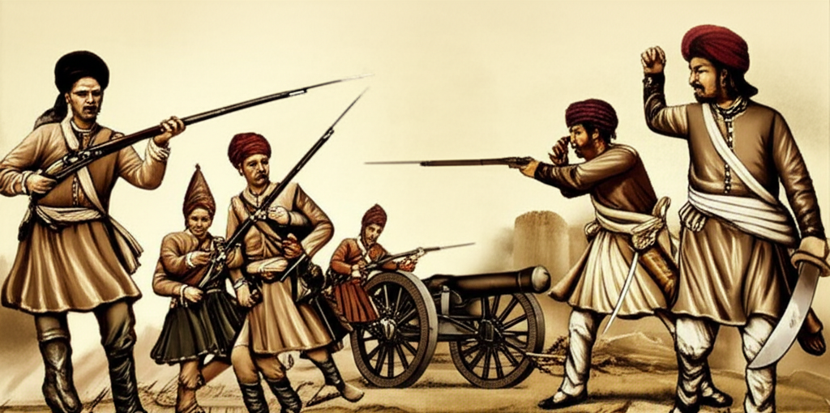
Roots of Resistance & Early Movements
Sepoy Mutiny of 1857: A significant early uprising.
Formation of the Indian National Congress (INC) in 1885.
Rise of Nationalist Sentiments: Calls for greater self-governance.
Emergence of influential early leaders and their contributions.
Source: Historical Archives of India

Slide 3
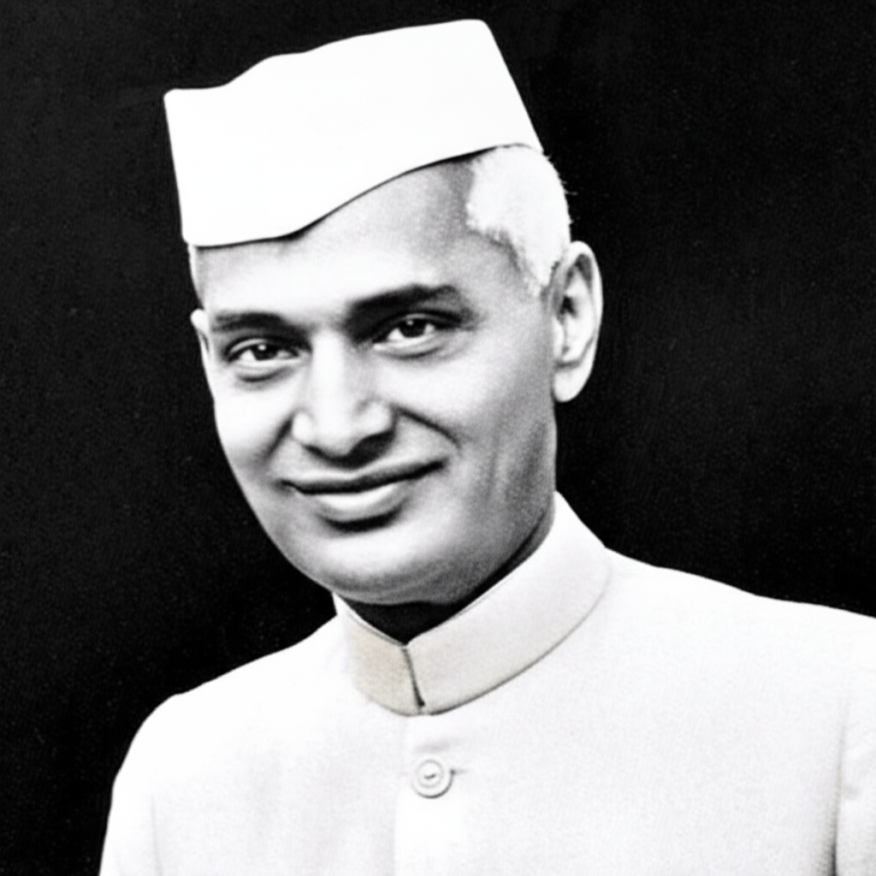
Architects of Independence: Key Figures & Ideologies
Mahatma Gandhi: | Jawaharlal Nehru:
Non-violent Civil Disobedience (Satyagraha) | First Prime Minister of India
Dandi March (Salt Satyagraha) | Vision for a Modern India
Quit India Movement (1942) | Subhas Chandra Bose:
 | Indian National Army (INA)
 | Sardar Vallabhbhai Patel:
 | Integration of Princely States
 | Source: Modern Indian History Texts

Slide 4
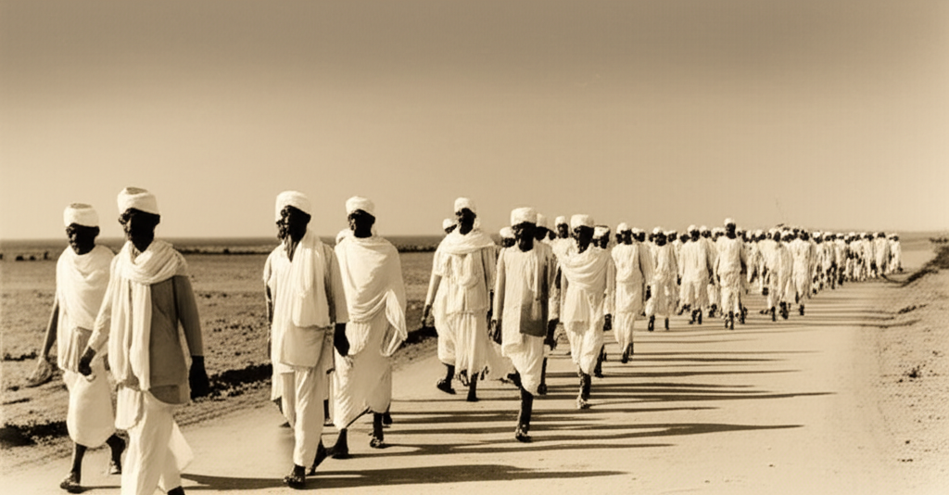
Pivotal Moments & Escalation of Struggle
Jallianwala Bagh Massacre (1919): A turning point in the struggle.
Non-Cooperation Movement (1920-22): Nationwide protests.
Simon Commission & Lahore Session (1929): Demand for Purna Swaraj (Complete Independence).
Government of India Act (1935): Granting provincial autonomy.
World War II and its impact on the British Empire's hold.
Source: Freedom Struggle Publications

Slide 5
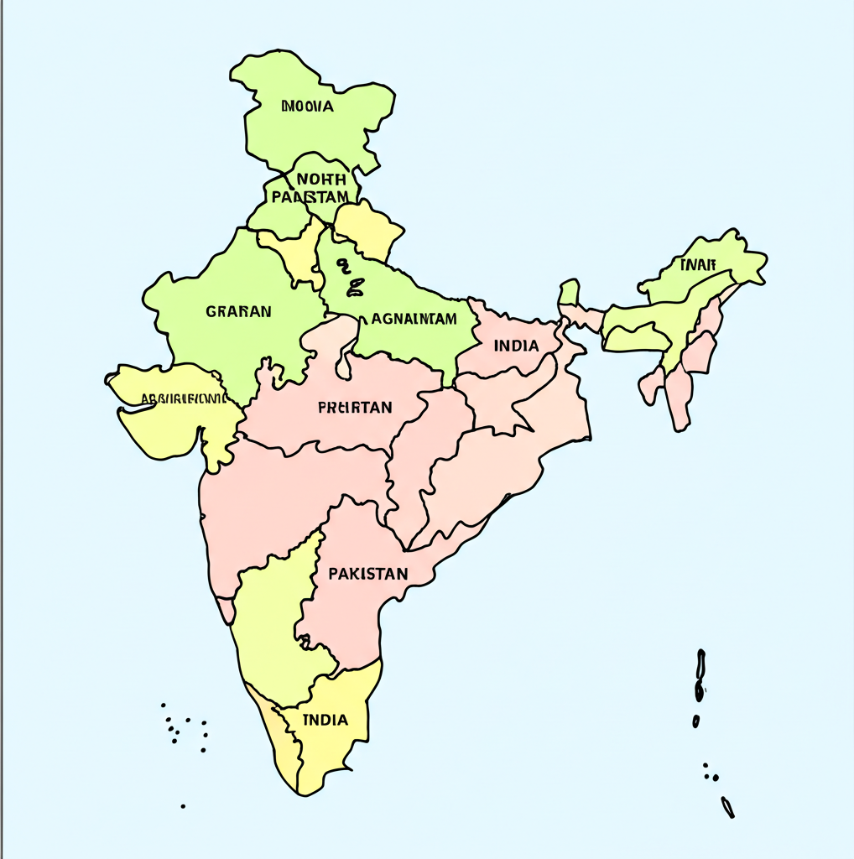
After decades of struggle, India gained independence on August 15, 1947. However, this freedom came with the tragic partition of the subcontinent into India and Pakistan, leading to widespread displacement and violence. The Radcliffe Line arbitrarily divided communities and regions. This period remains a significant and complex chapter in the nation's history. Source: Partition Chronicles.

Slide 6
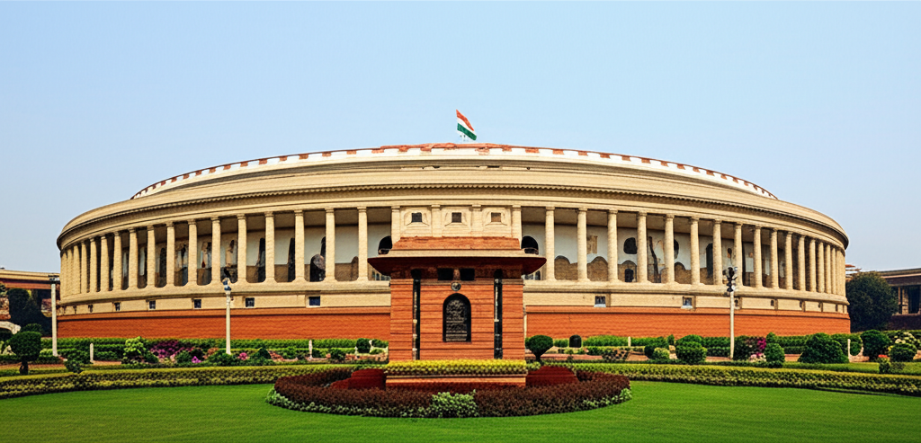
Legacy of Independence
Establishment of the Republic of India (1950): Adoption of the Constitution.
Founding of a Democratic Republic: Universal adult franchise.
Non-Aligned Movement (NAM): India's stance in the Cold War era.
Challenges and Achievements: Nation-building, economic development, and social reforms.
Continued relevance of Gandhian principles.
Source: Contemporary Indian History

